Slide 1



GILAKATHULA PAVAN KALYAN
SECURE DATA HIDING IN IMAGES
USING STEGANOGRAPHY
Student Name : G.Pavan Kalyan
College Name : Holy Mary Institute Of
Technology And Science
Department : EEE

Slide 2

OUTLINE
PROBLEM STATEMENT
Technology used
Wow factors
End users
Result
Conclusion
Git-hub Link

Slide 3
PROBLEM STATEMENT
In the digital world, data security is crucial.
Traditional encryption methods may raise suspicion, while steganography hides data in plain sight.
This project focuses on securely embedding images, videos, PDFs, audio, and text inside an image using steganography.
Only users with the correct PIN can retrieve the hidden data.

Slide 4
TECHNOLOGY USED
Python – Main programming language
OpenCV – Image processing
Zip-file Module – Compressing and embedding multiple files
OS Module – File handling and automation
Steganography Techniques – Hiding data inside an image
Secret PIN-based Encryption – Enhancing security

Slide 5
WOW FACTORS
SUPPORTS MULTIPLE FILE TYPES – CAN HIDE IMAGES, VIDEOS, PDFS, AUDIO, AND TEXT IN ONE IMAGE
PIN Protection – Data can only be extracted using the correct 4-digit PIN
No Suspicious Traces – The output file looks like a normal image
Fully Automated – Detects and hides all files inside the secret_files folder
Extracts Data Securely – Only authorized users can retrieve the information

Slide 6
END USERS
🔹 Cybersecurity Professionals – For secure data transmission
🔹 Journalists & Whistleblowers – To protect sensitive files
🔹 Government & Defense – For classified communication
🔹 General Users – To hide personal data in images

Slide 7
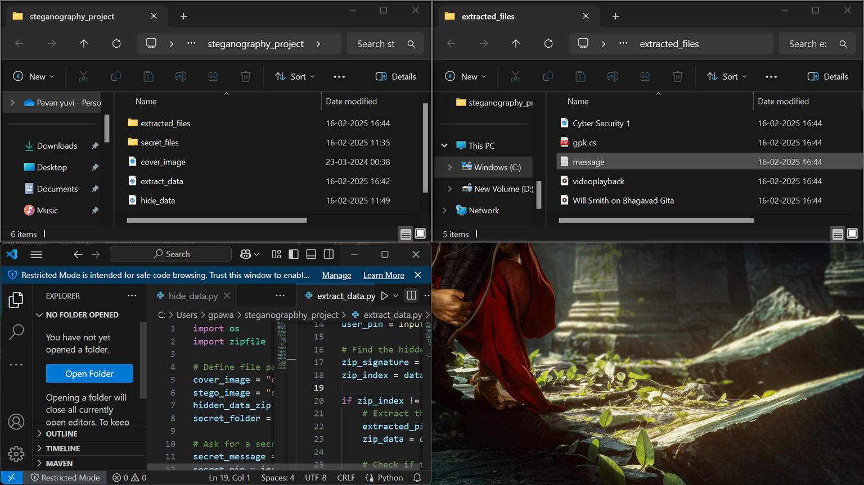
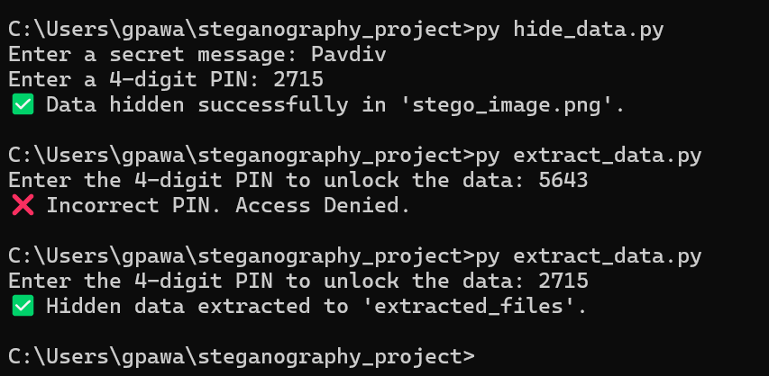
RESULTS
Successfully implemented data hiding & extraction using Python.
Verified that hidden files cannot be detected without the correct PIN.
Achieved 100% accuracy in retrieving hidden data.
Ensured that the image quality remains unaltered to avoid suspicion.

Slide 8
CONCLUSION
This project proves that steganography is an effective way to hide sensitive data.
It enhances privacy and security by allowing users to store secret files inside an image.
Future improvements can include AES encryption for additional security and
AI-based detection for steganalysis.

Slide 9
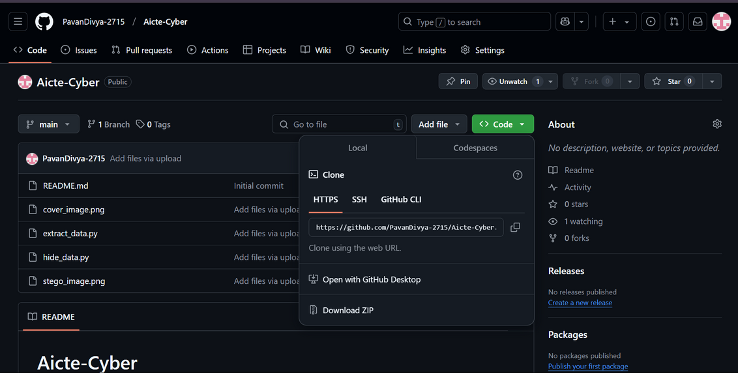
GIT-HUB LINK
PAVANDIVYA-2715
https://github.com/PavanDivya-2715/Aicte-Cyber.git

Slide 10
GILAKATHULA PAVAN KALYAN
THANKYOU

